Slide 1
X-section O-P
See Cross section locations.kmz & Cross section labels.kmz for location in Google Earth

Slide 2
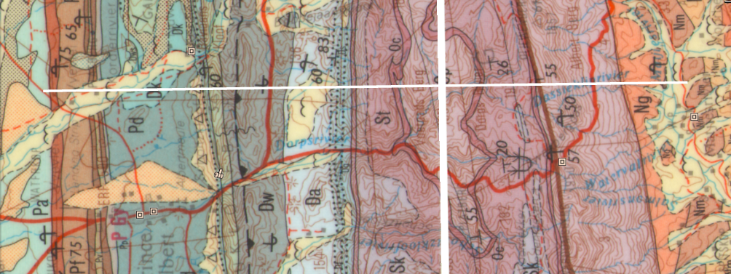

Council for Geoscience 1:250K Geology 3322 Oudtshoorn
TN
O
P
Teeberg viewpoint
Swartberg Pass
Km
3 km east of Teeberg viewpoint
3
St
2
Pw
Oc
1
Pa
Pr
Op
Pf
Pv
0
Pp
Pd
Dk
Undifferentiated Kango Group
Dws
-1
Dw
Dt - Db
Da
Sb
-2
Sk
– Ds – Dh –
St
Oc
-3
Dg – Dgs
Op
O
P
0
5
10
15
20
Km

